Slide 1
Medical Image Analysis
Pneumonia Chest X-Ray Classification

Slide 2
Team Members
Kanishaka Pranjal
(S20210010108)
Mohammed Faizan Ali
(S20210010149)
Yash Sanjay Kumbhar (S20210010127)
Mayank Singh
(S20210010140)

Slide 3
Overview
Introduction
Code Implementation
Problem statement
Conclusion

Slide 4
Introduction
Pneumonia is a lung infection that can be caused by bacteria, viruses, or fungi.
It is a serious illness that can lead to hospitalization and death, especially in young children and the elderly.
Chest X-rays are the most common imaging modality used to diagnose pneumonia.
Medical image analysis can be used to develop automated systems for the detection and classification of pneumonia on chest X-rays.

Slide 5
Problem statement
Develop and assess three deep learning models for classifying chest X-ray images as "Normal" or "Pneumonia." Models include a simple neural network, a convolutional neural network (CNN), and a CNN with residual connections. Key objectives:
Model Development: Implement, compile, and train the models.
Performance Evaluation: Compare model performance using accuracy, loss, and validation scores.
Visual Exploration: Explore the dataset visually for insights.
Data Augmentation: Apply image data generators for training and validation.
Early Stopping: Implement mechanisms to prevent overfitting.
Model Comparison: Analyze and compare model strengths and weaknesses.
Expected outcomes include improved understanding of model performance and potential applications in pneumonia detection.

Slide 6
Code Implementation

Slide 7
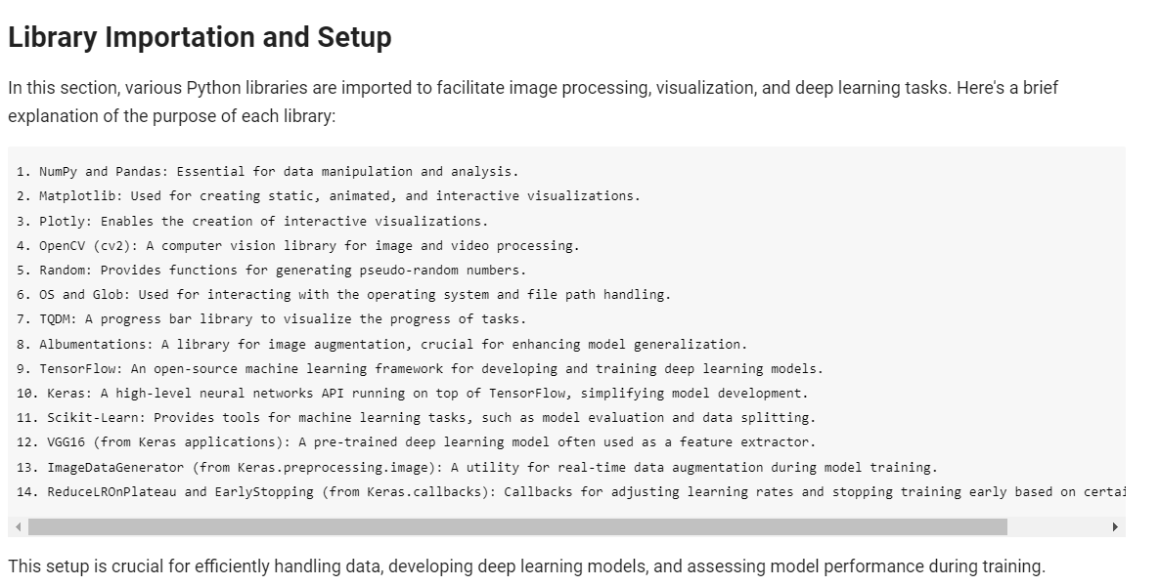

Slide 8
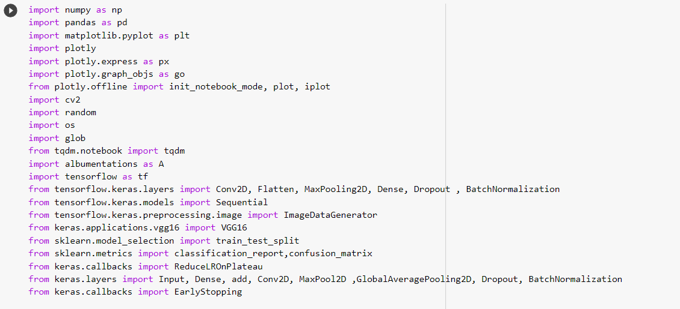

Slide 9
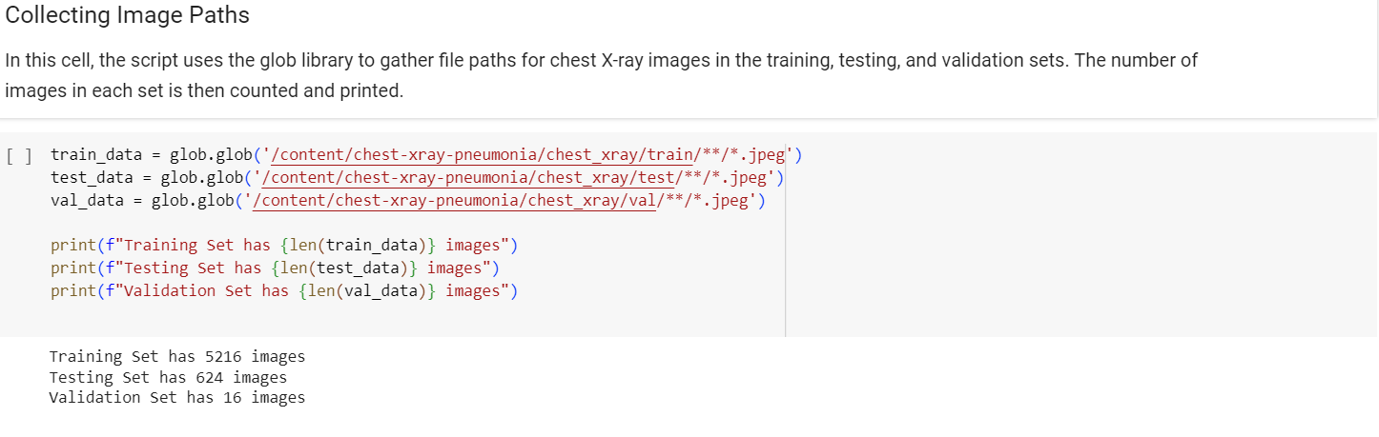
Dataset Exploration and Categorization

Slide 10
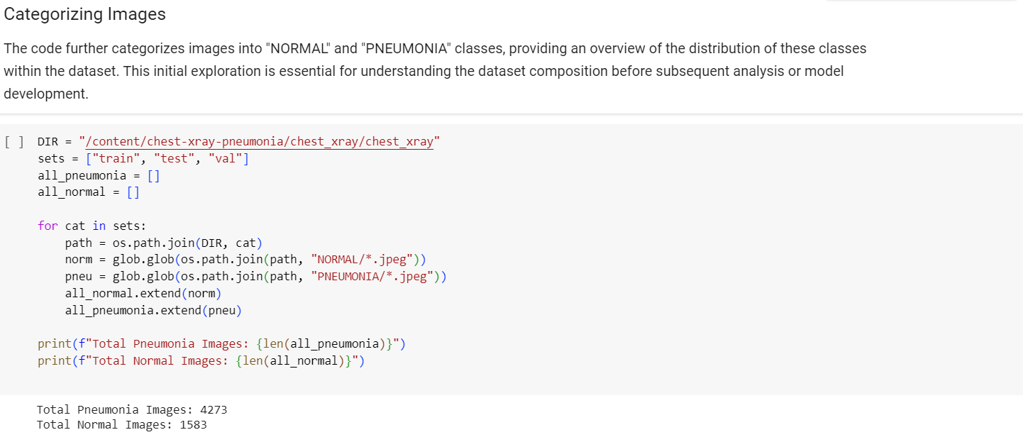

Slide 11
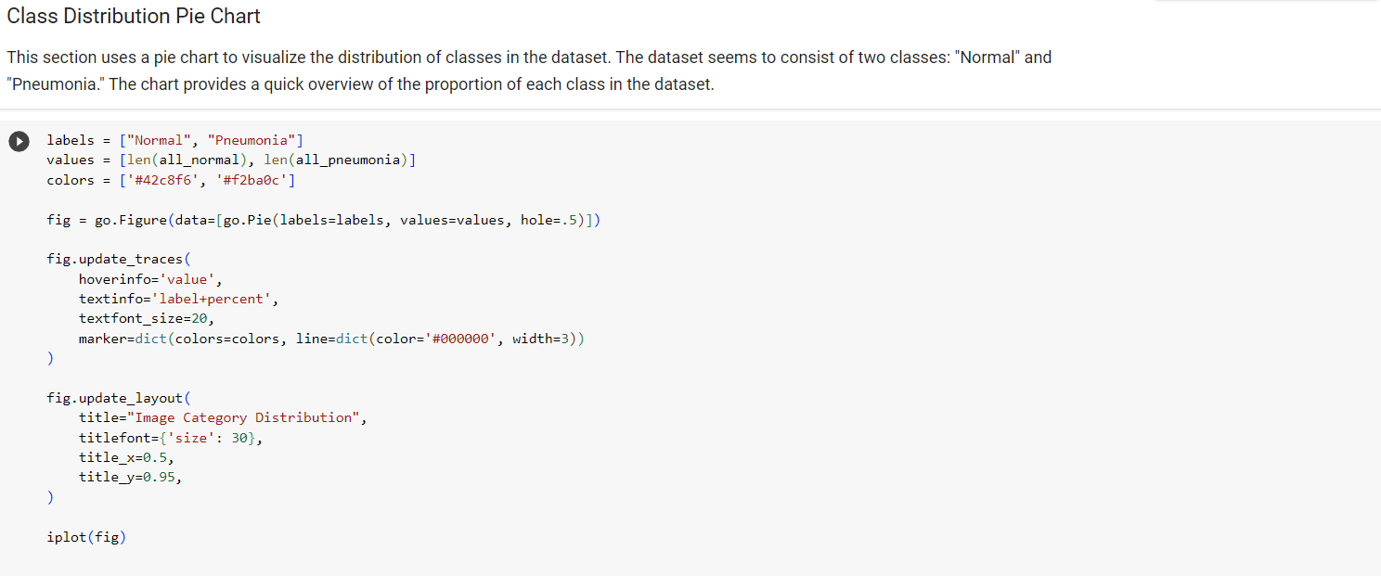
Basic Data Exploration :

Slide 12
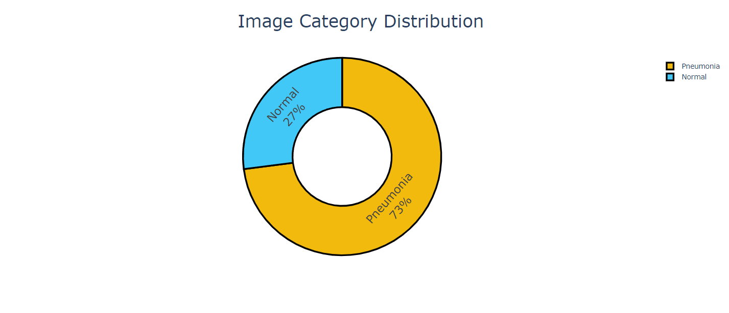

Slide 13
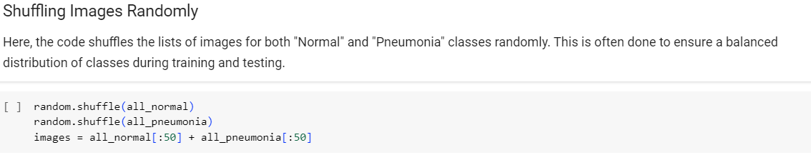
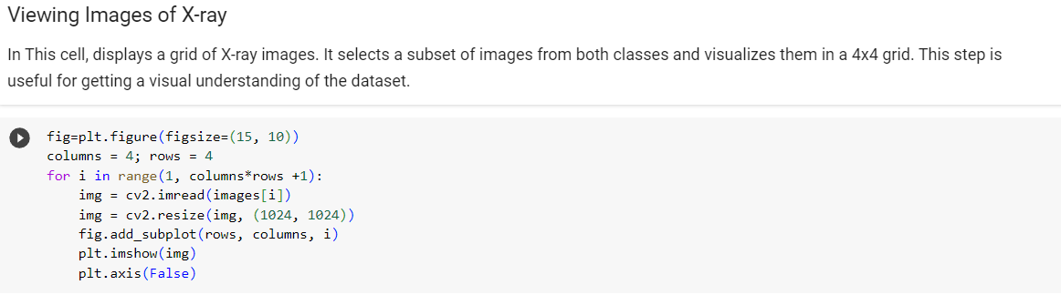

Slide 14
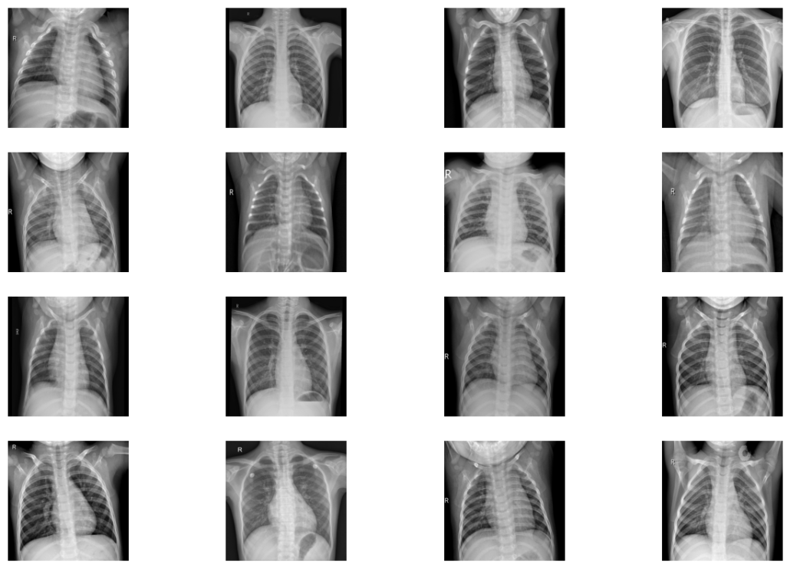

Slide 15
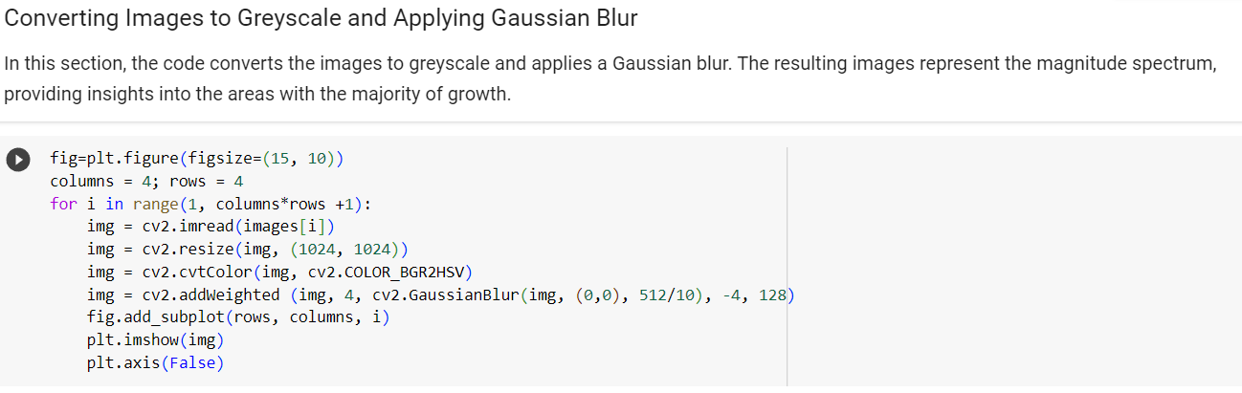

Slide 16
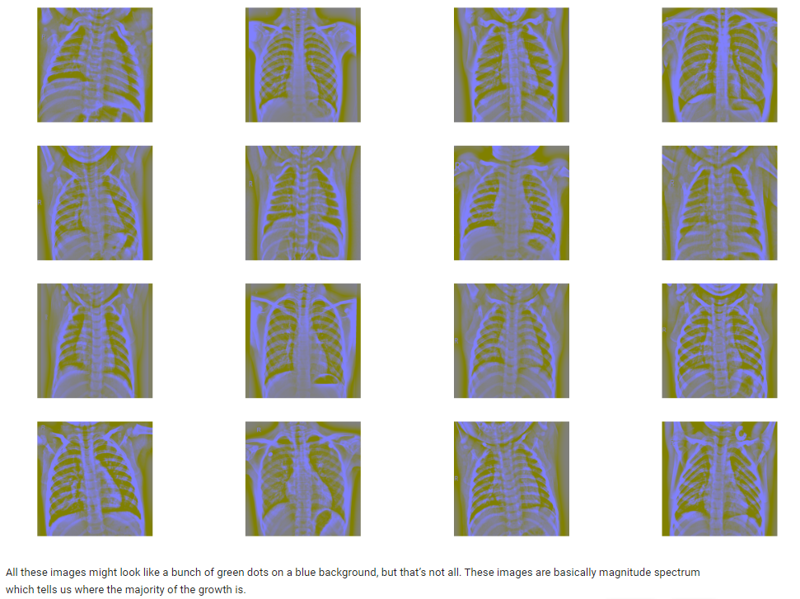

Slide 17
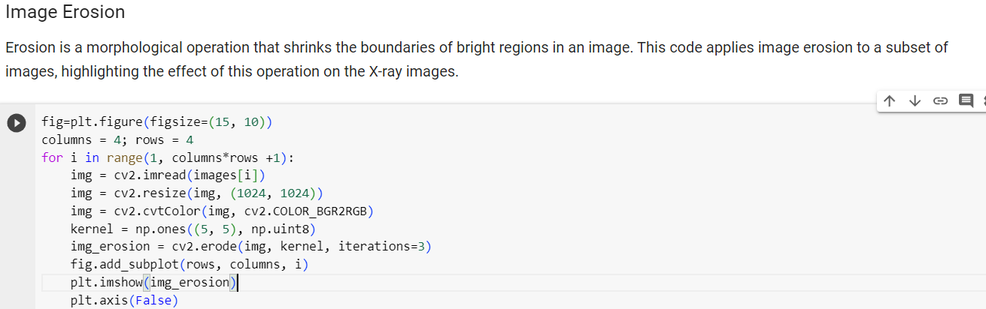

Slide 18
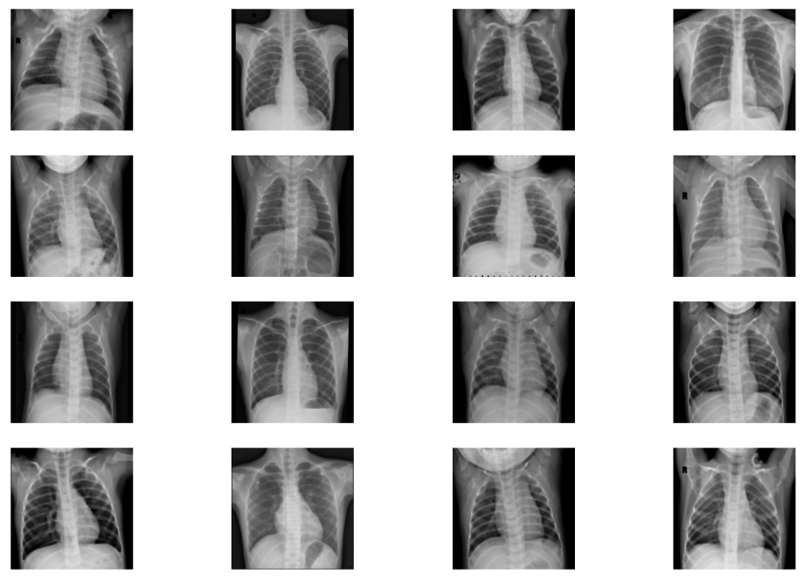

Slide 19
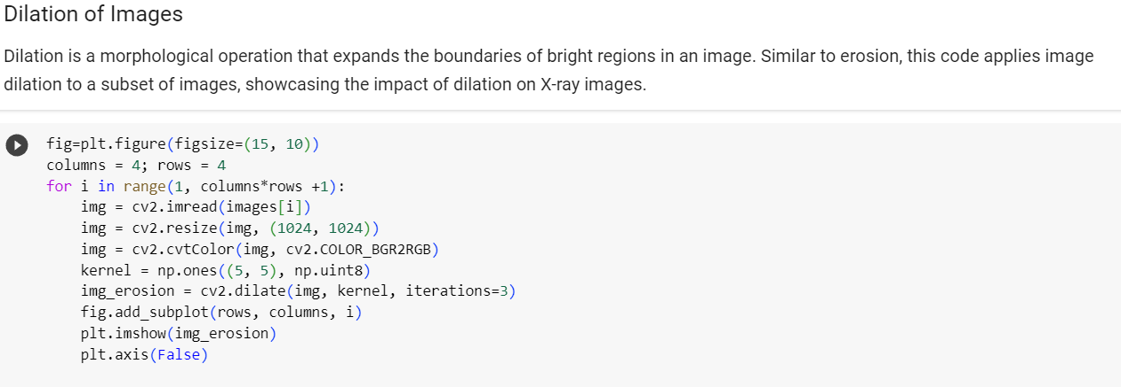

Slide 20
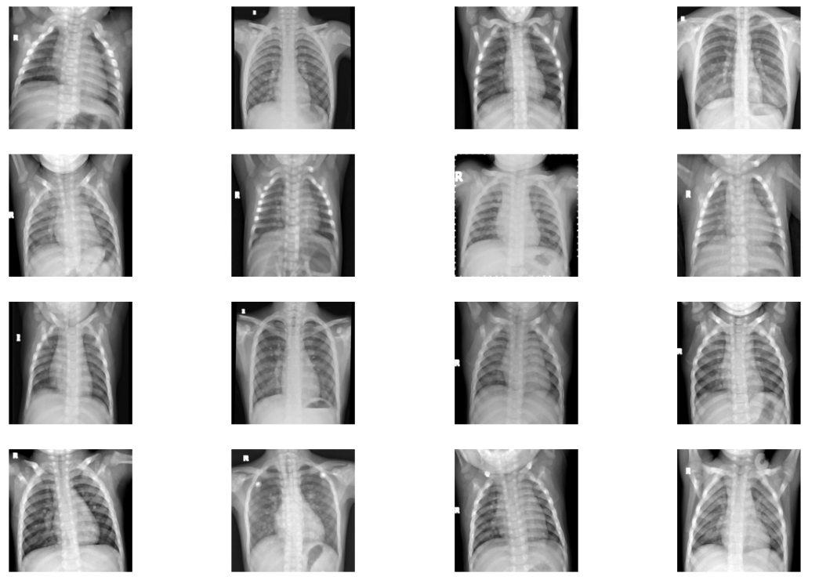

Slide 21
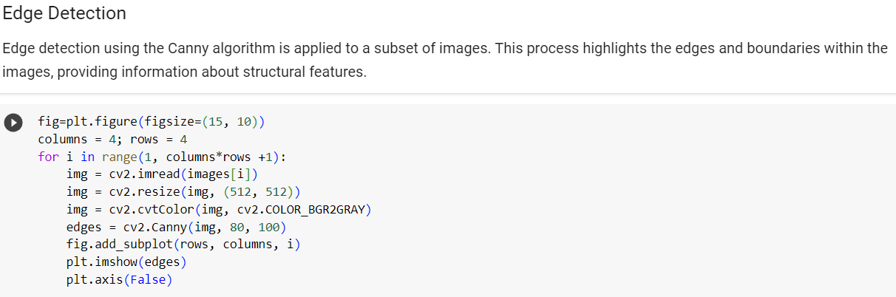

Slide 22
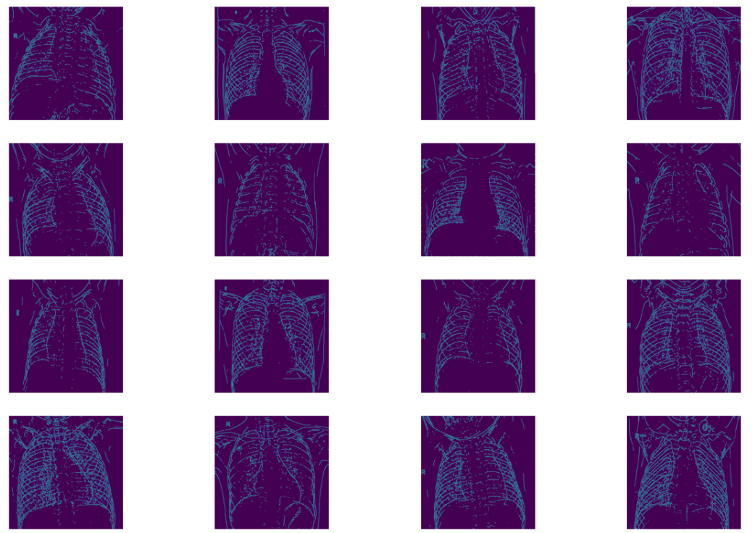

Slide 23
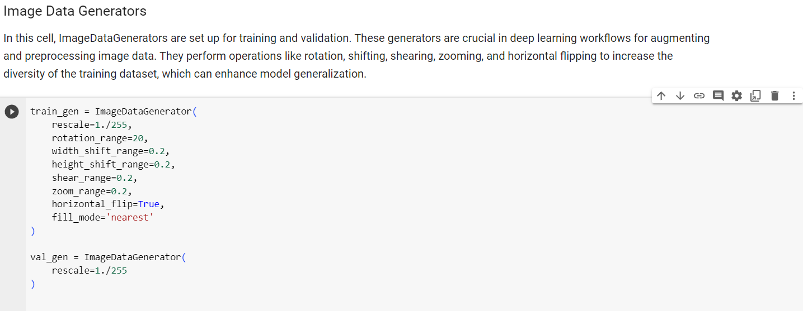

Slide 24
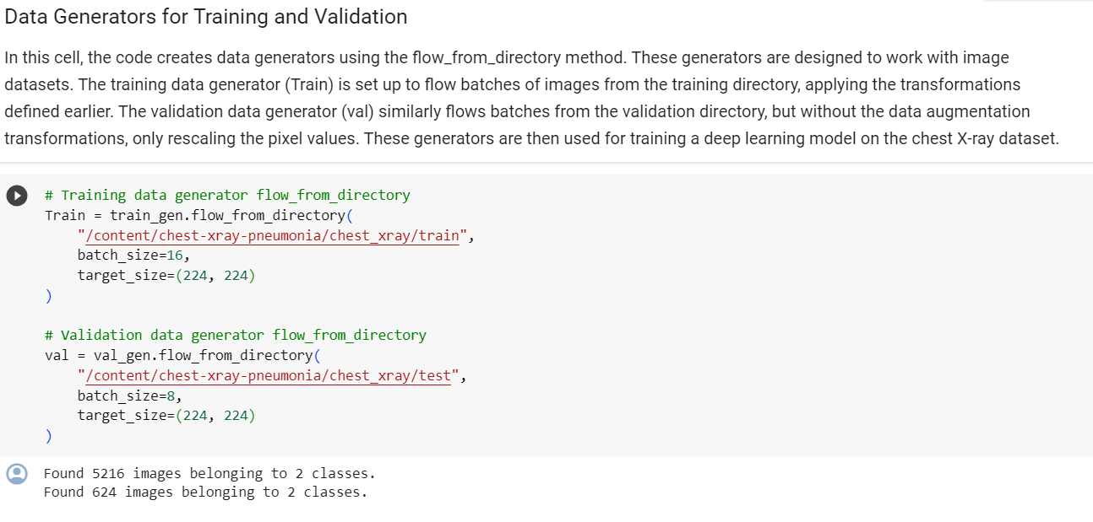

Slide 25
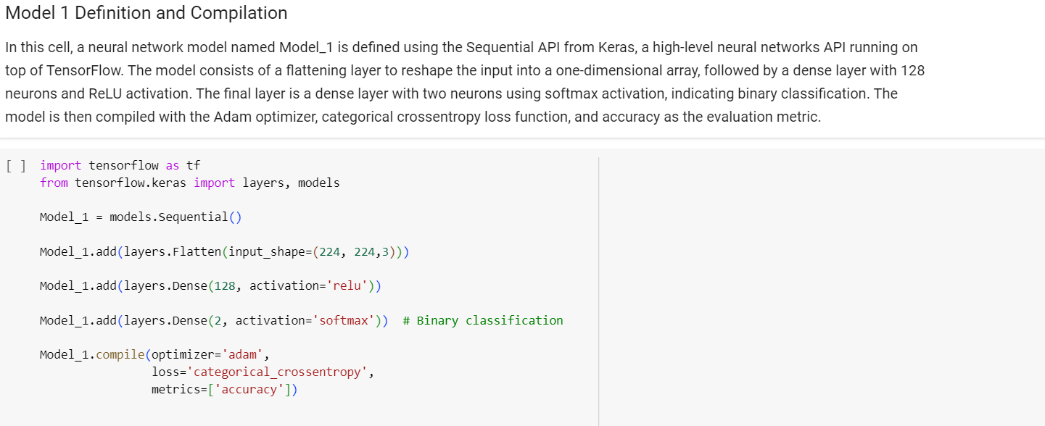
Model 1

Slide 26
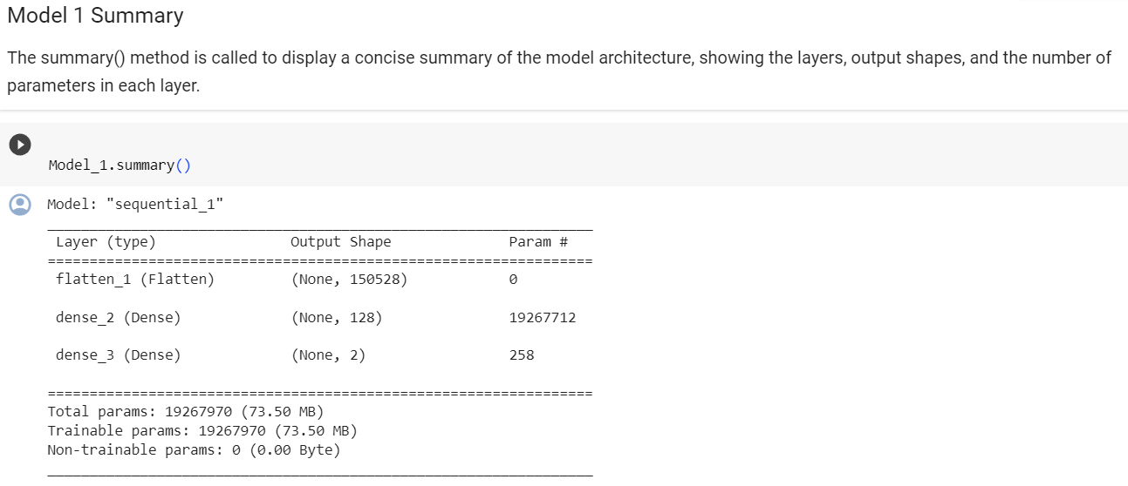

Slide 27
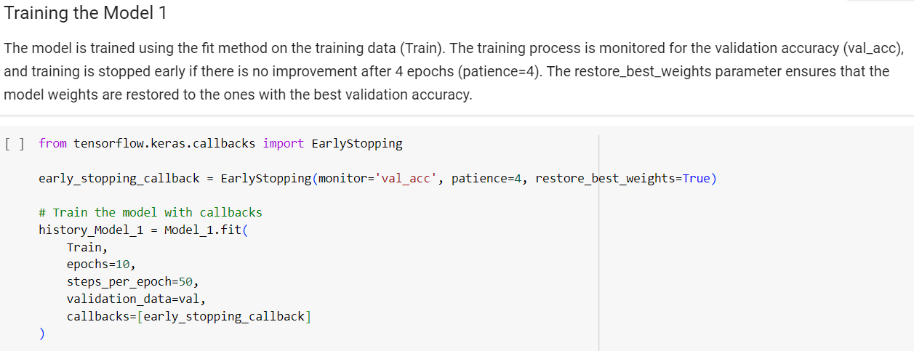

Slide 28
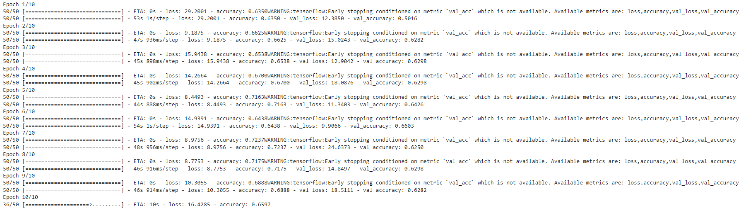

Slide 29
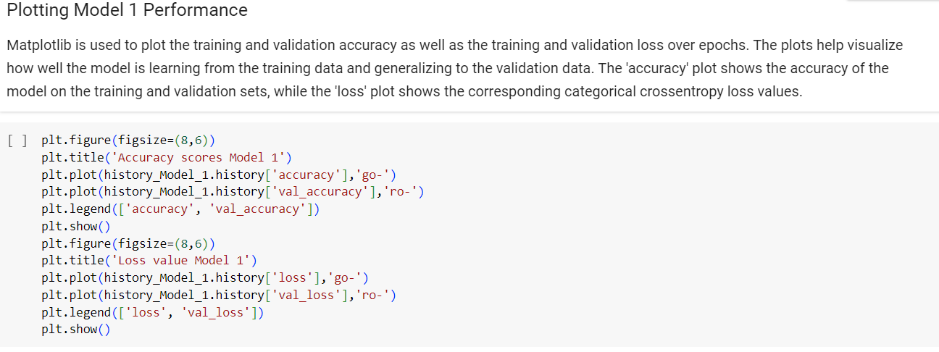

Slide 30
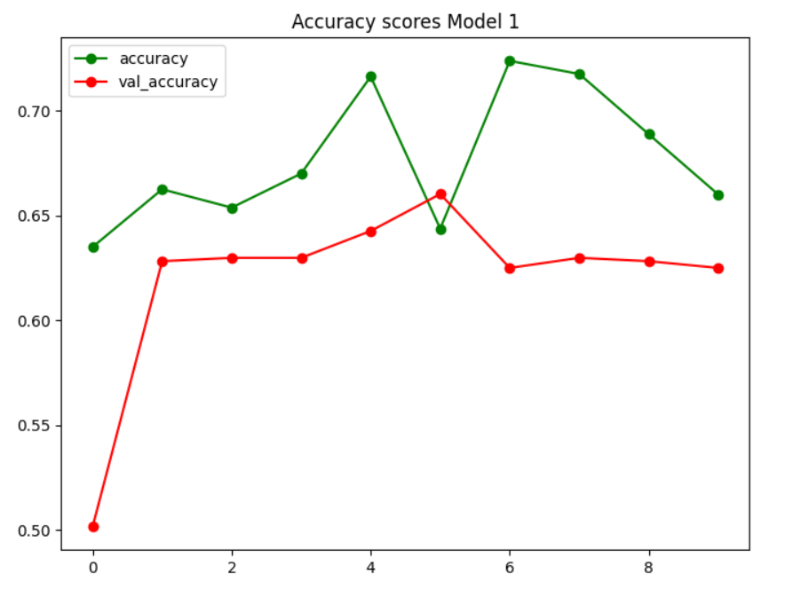

Slide 31
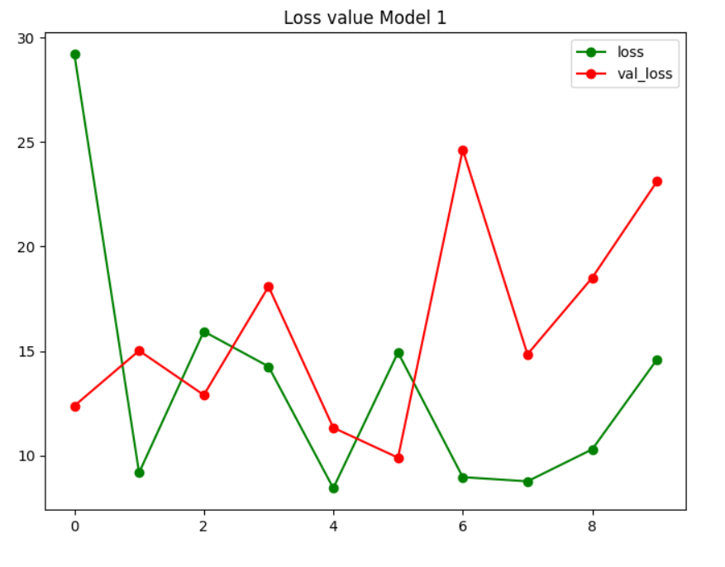

Slide 32
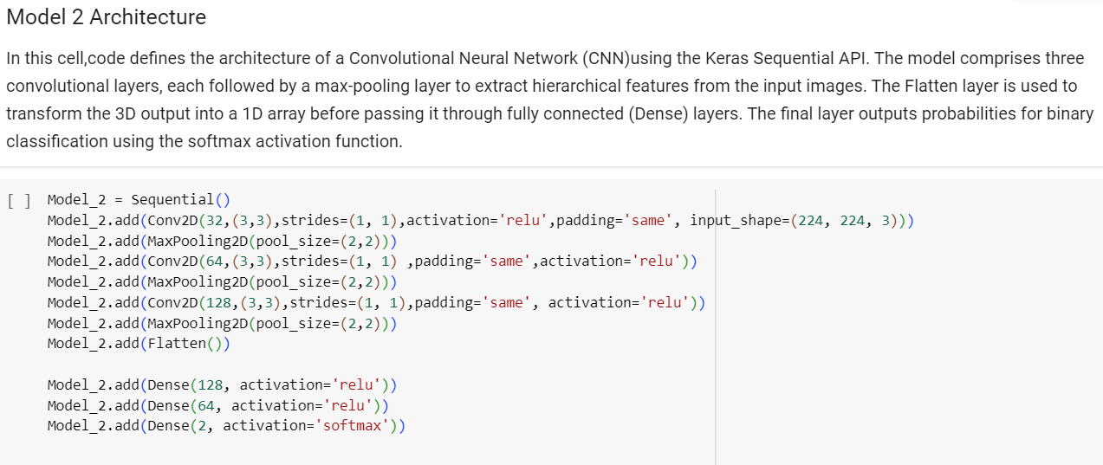
Model 2

Slide 33
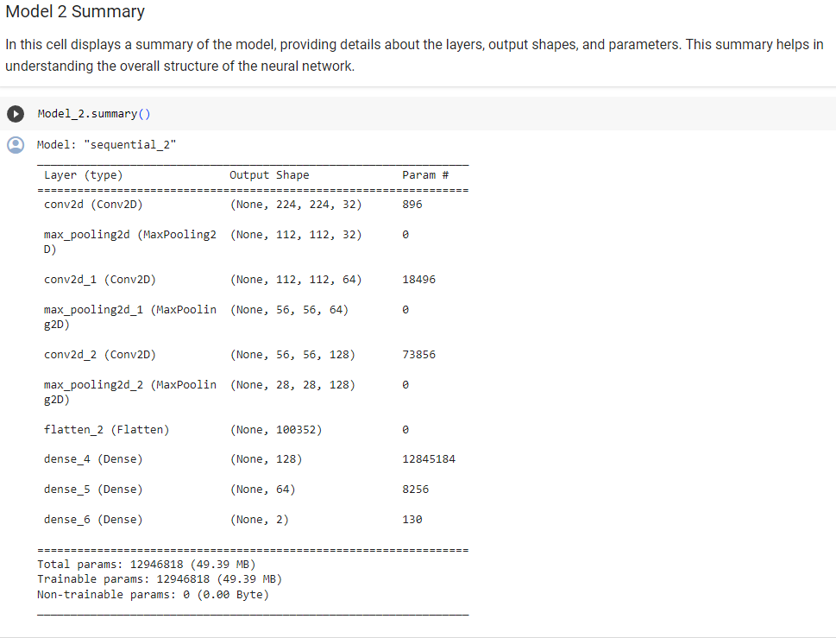

Slide 34
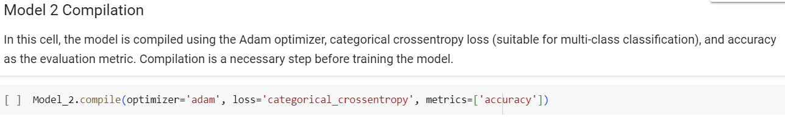

Slide 35
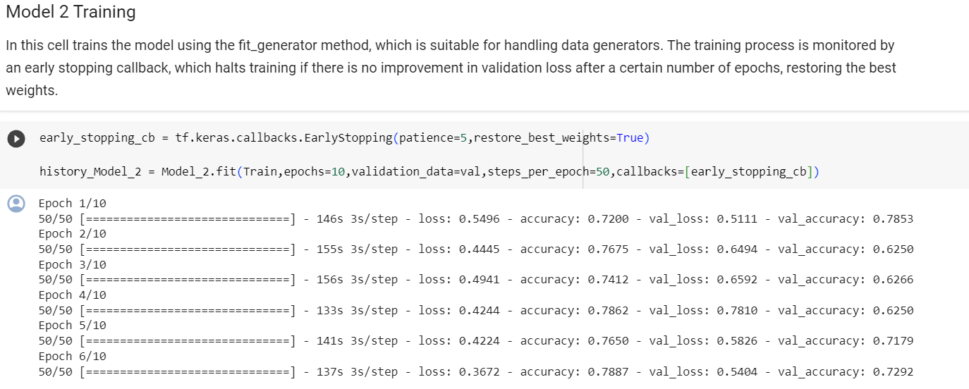

Slide 36
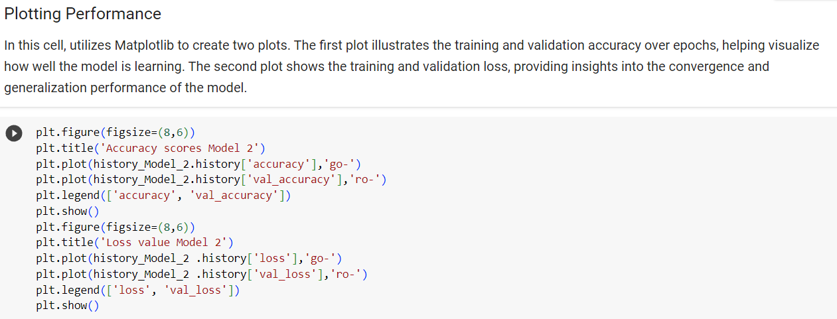

Slide 37
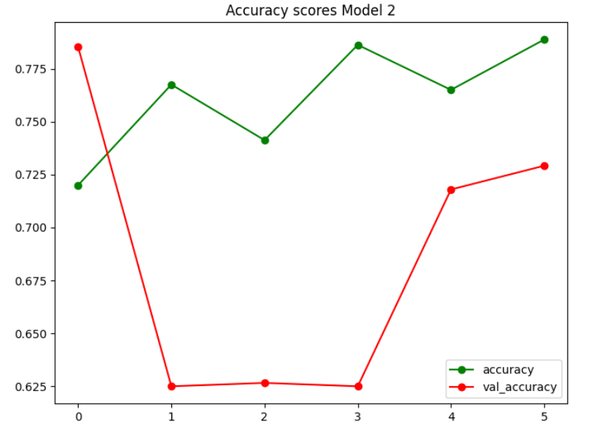

Slide 38
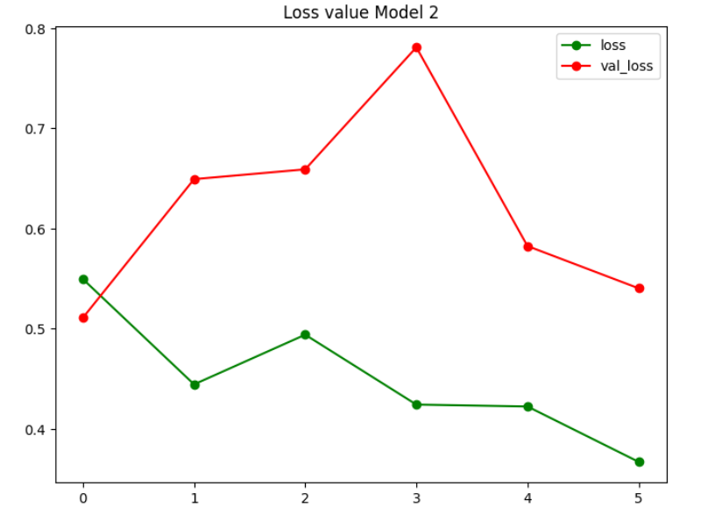

Slide 39
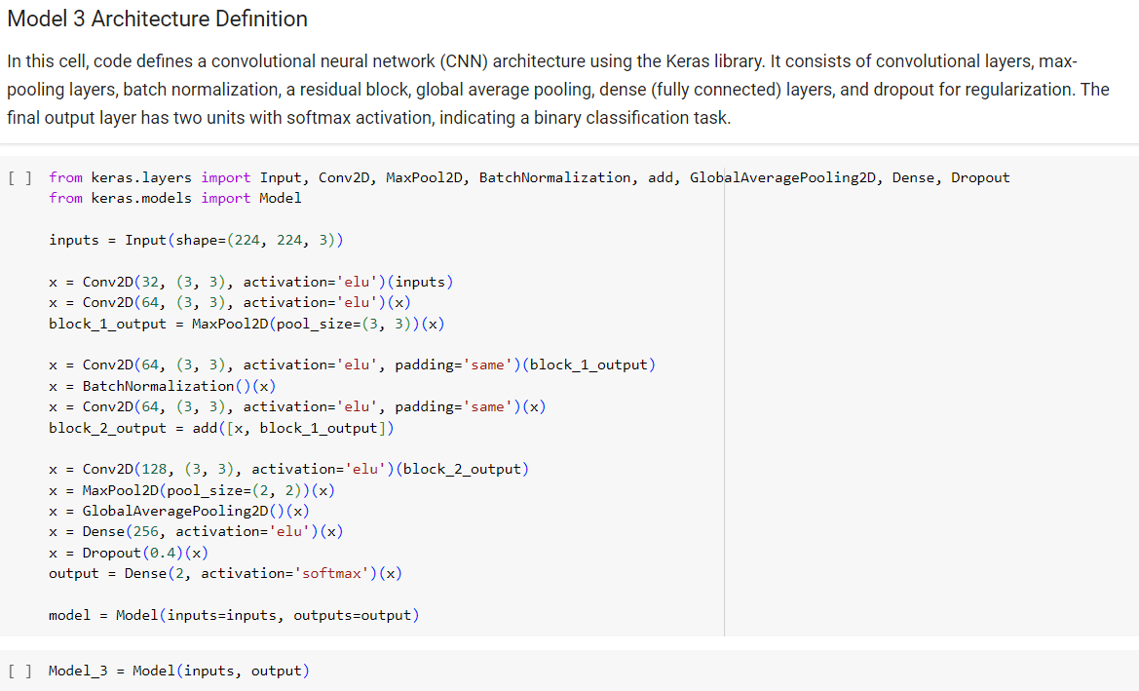
Model 3

Slide 40
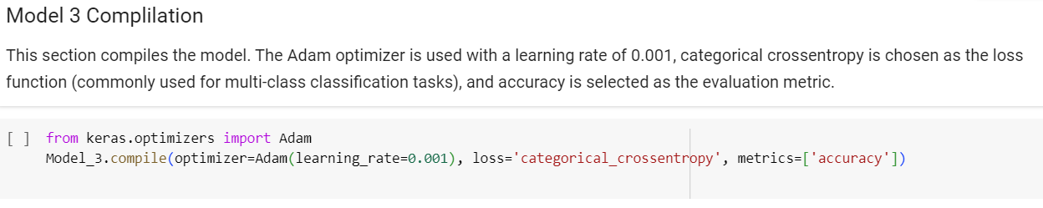

Slide 41
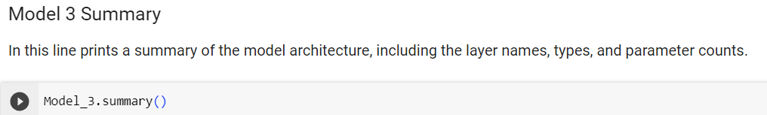

Slide 42
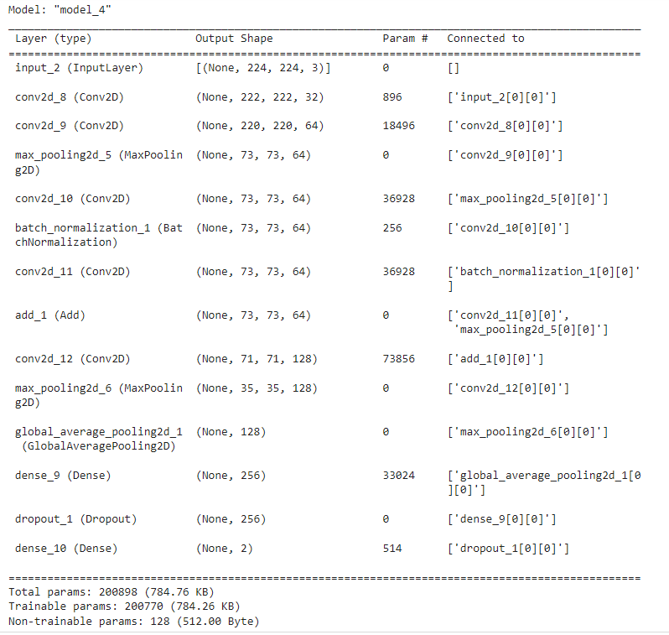

Slide 43
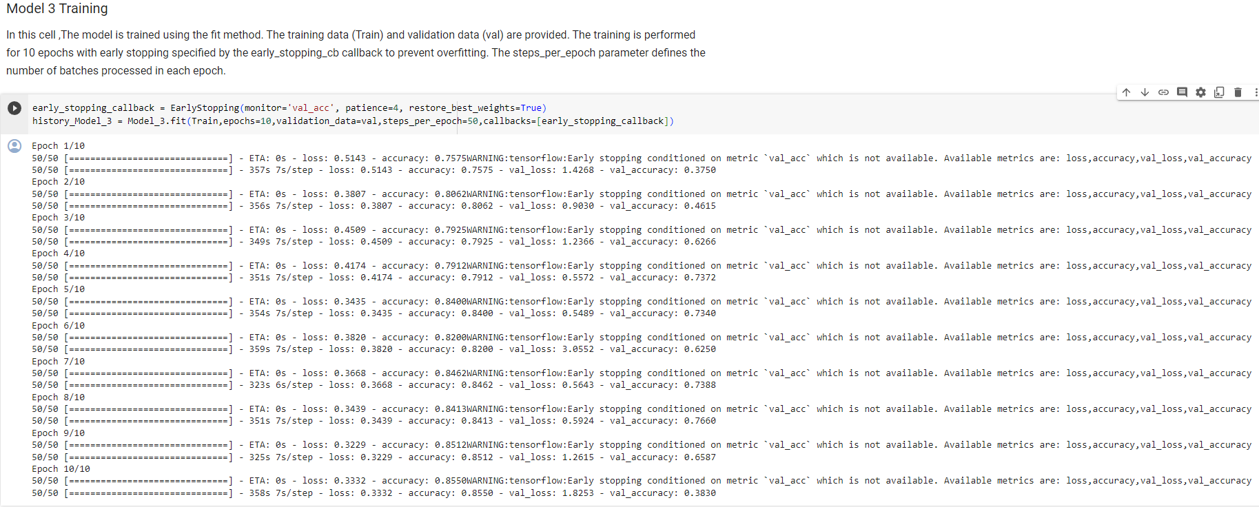

Slide 44
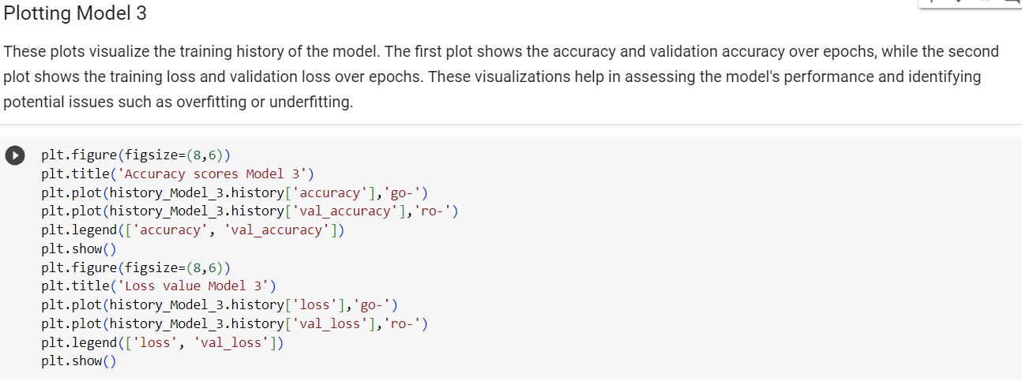

Slide 45
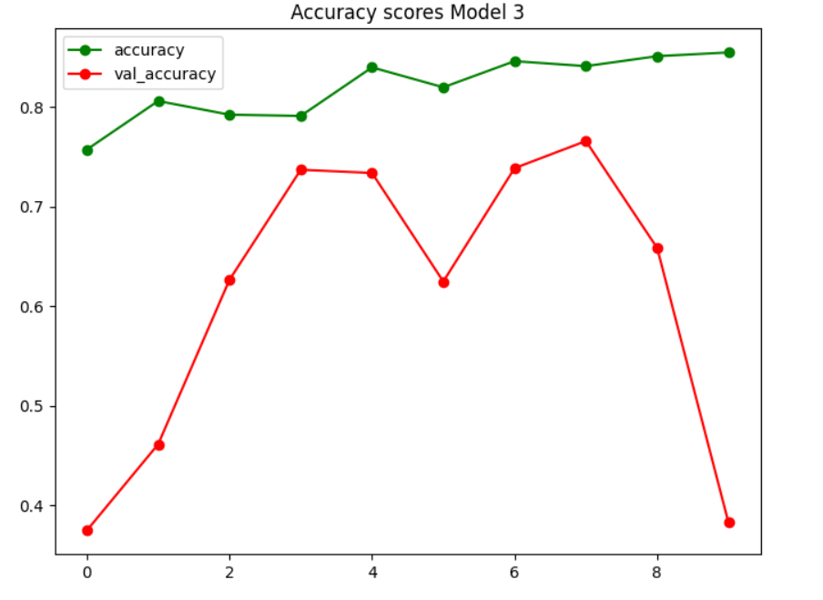

Slide 46
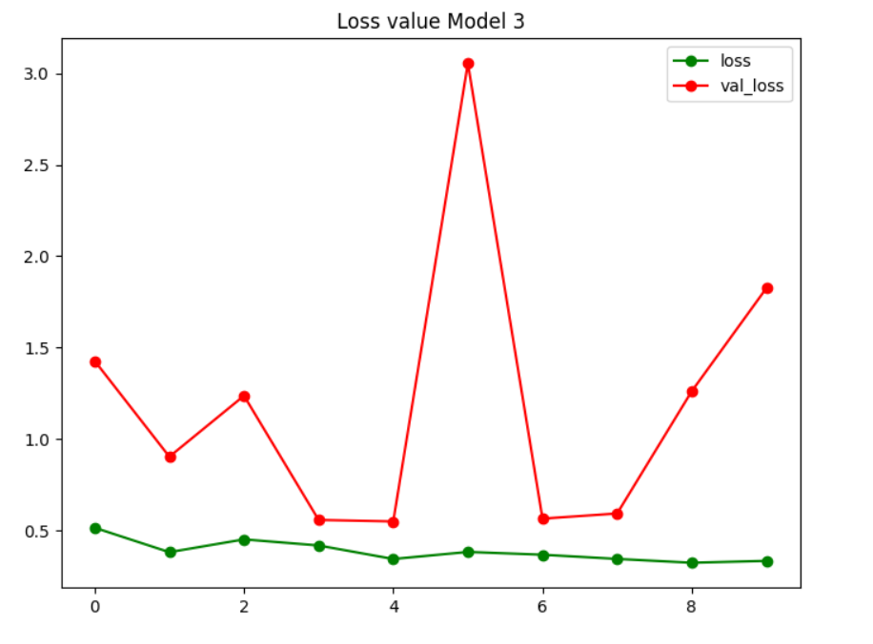

Slide 47
Conclusion
We conducted a comprehensive analysis of a chest X-ray dataset for binary classification of pneumonia. The dataset was explored, and key insights were gained through various data visualization techniques. The distribution of classes was visualized using a pie chart, and a subset of X-ray images was displayed to gain a visual understanding of the dataset.
Basic image processing techniques were applied, such as converting images to grayscale, applying Gaussian blur, erosion, dilation, and edge detection. These transformations provided insights into different aspects of the images, such as structural features and areas of growth.
Data generators were set up for training and validation, and three different models were implemented: Model 1 (a simple neural network), Model 2 (a convolutional neural network), and Model 3 (a more complex CNN with ResNet Blocks).
The models were trained and evaluated, and their performances were visualized using Matplotlib. The accuracy and loss plots over epochs provided insights into the training process and the generalization of each model.
In summary, this notebook covered data exploration, image processing, model implementation, and evaluation. The analysis and visualizations serve as a foundation for further fine-tuning of models and understanding their effectiveness in classifying chest X-ray images for pneumonia detection.

Slide 48
Thank You

